Slide 1
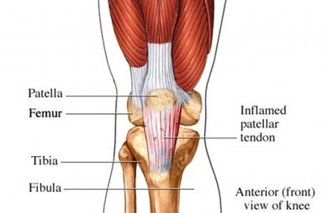
Patellar Tendinopathy

Slide 2
Development of Patellar Tendinopathy

Slide 3
Common disorder amongst recreational and elite athletes
Repetitive microtrauma to the patellar tendon coupled with insufficient recovery time leads to painful tendon swelling
Microtrauma can result from frequent acceleration, deceleration, jumping, deep squatting, and landing

Slide 4
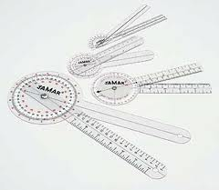
Other causes:
Muscle imbalances
Skeletal alignment abnormalities
Flat feet
Muscle length discrepancies
Decreased ankle dorsiflexion range of motion
Poor training technique
Obesity

Slide 5
Symptoms

Slide 6
Anterior knee pain felt behind, below, or to the sides of the patella
Symptoms increase with knee flexion activities
Pain will be first noticed when standing from a seated position, where knee flexion is maintained for a period of time
Pain may be alleviated by activity then get worse over the course of an activity session

Slide 7
Differential Diagnosis Tests

Slide 8
A clinician needs to rule out the following:
Patellar chondromalacia
Articular cartilage damage
Patellar-fermoral pain syndrome
Begins with detailed subjective examination with attention to training schedule and daily activities, length of painful episode, and mechanism of injury
most commonly will notice insidious onset

Slide 9
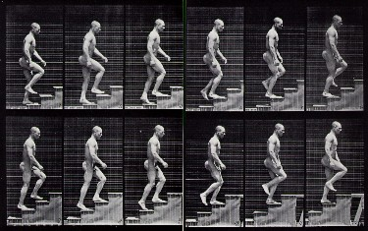
Functional tests and symptom behavior post test
Ascending/Descending stairs
Single leg hopping, jumping, and squatting
Reports of instability with increased loads
Palpation to the patellar tendon will produce pain and possible effusion

Slide 10
Diagnostic Imaging

Slide 11
Ultrasound and MRI can be beneficial to rule out articular cartilage or meniscal injuries
Radiographs are not considered helpful

Slide 12
Recommendation

Slide 13
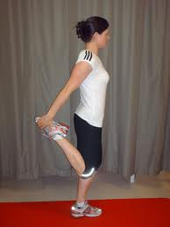
Controlled rest periods is essential
Initially treatment should consist of:
Stretching
patient education on adjusting body mechanics
iontophoresis

Slide 14
As pain becomes managed eccentric trainings of the patellar tendon and rectifying muscle strength imbalances as well as continued patient education on recovery periods is advised
Tell the patient that patellar tendinitis recovery is a lengthy process which can take a few weeks to almost a year until symptoms fully subside

Slide 15
Prognosis

Slide 16
Conservative treatment typically resolves symptoms
Surgery rarely necessary
If proper time and attention given to rehabilitation efforts, prognosis is positive

