Slide 1
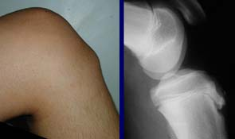
Osgood Schlatters

Slide 2
What is
Osgood Schlatters?

Slide 3
Aseptic necrosis of the tibial tuberosity arises during the growth years, causing local swelling and pain.
Osgood Schlatters is inflammation of the growth plate at the tibial tuberosity, boys and girls ages 11-15 going through growth spurts, generally affects males more.

Slide 4
How does
Osgood Schlatters
develop?

Slide 5
Develops in an adolescent engaged in a jumping sport and complains of pain in the tibial tuberosity.
In older adolescents, on should suspect patellar tendinitis (jumper’s knee)
Caused by stress on the patellar tendon, repeated contraction of the quadriceps is transmitted through the patellar tendon on the immature tibial tuberosity, this can cause subacute avulsion fractures along with inflammation of the tendon, leading to excess bone growth at the tibial tuberosity

Slide 6
Examination

Slide 7
Manual Muscle Test
Quadriceps may be weak
Palpation of the Tibial Tuberosity
Tenderness may be present
Percussion on tibia away from patellar tendon attachment to rule out stress fracture
Ober’s test
Positive test may indicate tightness of the iliotibial band and tensor fascialata

Slide 8
What is the
Outcome of Treatment?

Slide 9
Treat and Refer
Physical therapy: focus on
weight bearing and normalized gait patterns
Increase quadriceps strength and general lower extremity
Increase general lower extremity flexibility
Prognosis: Good

Slide 10
Reference
DeLee: DeLee and Drez's Orthopaedic Sports Medicine, 3rd ed. Copyright © 2009 Saunders, An Imprint of Elsevier.

